Slide 1


Deploying to Github Pages

Slide 2

Agenda
What is deployment and some deployment platforms.
Linking a remote repository to a local one. Two scenarios:
You already started to work locally, without a remote linked to it. (Local repository ahead from remote). Preferable to start with an empty remote repository, so we can push our local changes.
The work is in the remote, and you need to keep on working. (Remote repository is ahead from local). Preferable to use git clone to bring the latest changes and keep on working.
What is Github Pages, and how to deploy a simple project to it.
In case that you are not the owner of the repository, how to link your local work to two repositories, and use one of them for deploying.

Slide 3
Deployment
Deployment:
Making software available for use.
In this presentation, we will connect our local repository to a remote to deploy.
In this presentation, we will deploy the portfolio that you have created so that you can make it available for others to see.
Notes:
To deploy, you will need to have your project connected to a remote repository. This guide includes a step by step how to do it.

Slide 4





Other deployment Platforms
Heroku
Amazon Web Services (AWS)
Firebase Hosting (Google Cloud)
Microsoft Azure
Netlify

Slide 5
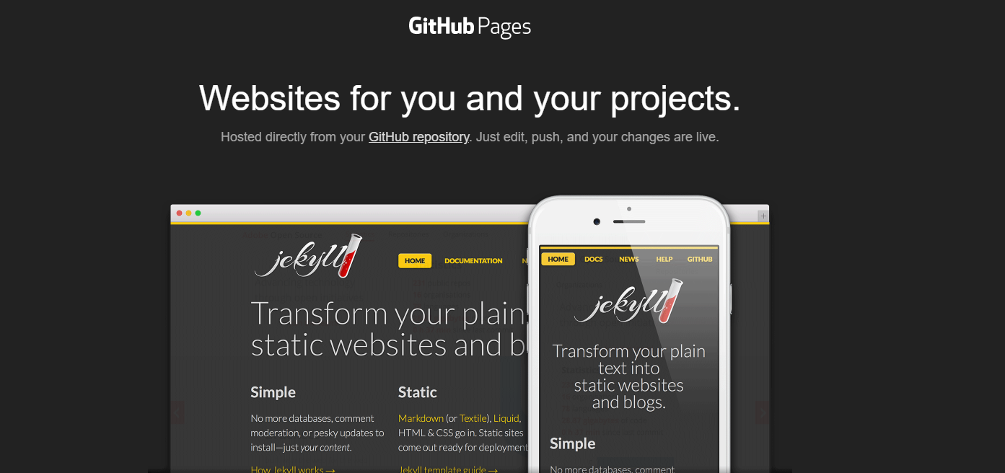
Deployment
Deploying with Github Pages: https://pages.github.com/

Slide 6
Why Github Pages
Deploying with Github Pages: Github has its own deployment tool. It is very simple: doesn’t allow the configuration of environment variables.
What is it good for?
Simple HTML pages.
What are the downsides:
No servers or databases to configure
No possibility to set environments variables.
You need to have access to the settings of the repository. If you are not the owner you won’t be able to. But there is a workaround: create a new repo, and publish your work to that one.

Slide 7
Deploying to Github Pages
Some considerations:
You need to have administrative rights in the remote repository to deploy to Github Pages. If you don’t, you will need to create another repository, link it to it, and deploy on the new one.
Steps:
#1: install git on your computer (you have slides on the classroom on how to do it)
#2: Connect to a remote repository (create / link to an existing one). There are several git remote providers (Github, GitLab, Bitbucket, etc). We are using GitHub for this one
#3: Publish your work: commit it and push it to the remote repository
#4: Deploy to GitHub pages

Slide 8

Deploying to Github Pages
#1. Installing Git: In the first place, we will need to have Git installed.
Open a terminal/cmd/git bash window and type:
git --version
If you don’t have it installed go to:
https://git-scm.com/book/en/v2/Getting-Started-Installing-Git
And follow the steps for your O.S. We have guides on how to do the step by step for all OS.

Slide 9
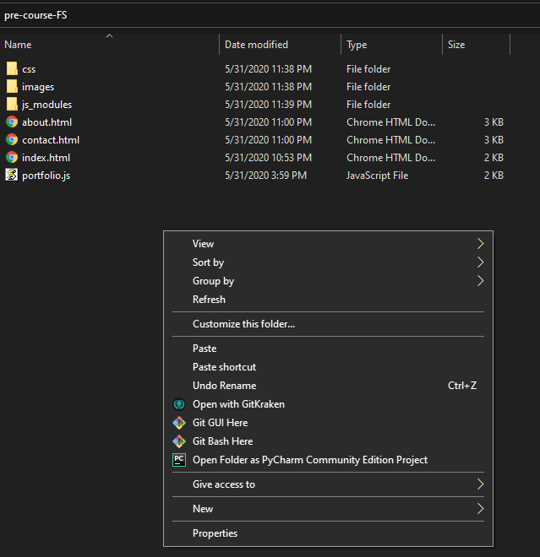
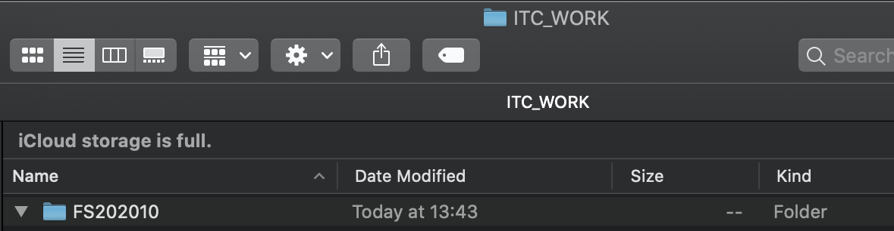
Deploying to Github Pages
#2: Connecting to a remote.
Open a terminal at the location of your project. You can do it by navigating in your explorer (Windows Explorer, Finder, Gnome) and right clicking on the proper option to open a terminal at that location. We will check if there is a remote connected to it.
👆Right click and “New terminal at Folder”

Slide 10
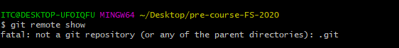
Deploying to Github Pages
#2: Connecting to a remote.
Let’s check if there is a remote:
git remote show
Git remote show it is a command to show the connections to remote repositories.
The message that we have, is that there is no git repository (local). Without a local repository, is not even possible to link to a remote one. We will need to create it.
As explained, we have to options:
If there is no code in a remote, it is advisable to initialize a git repository locally, and then push the work to the remote.
If the project has already started (there is code in the remote) and we need to keep on working, it is advisable to first clone the project in an empty folder.
We will go for the first one in this case.

Slide 11
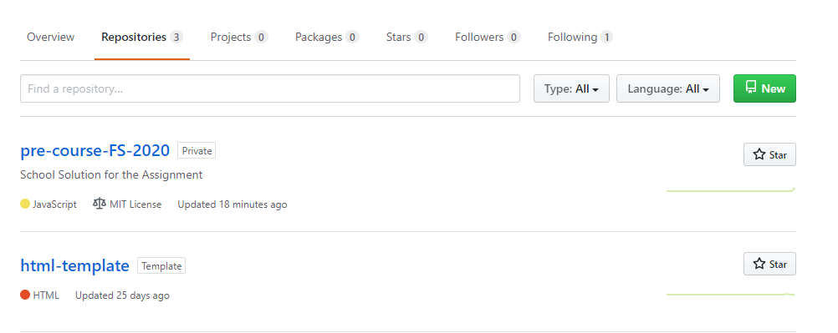
Deploying to Github Pages
#2 A: Case there is no remote repository: Create one.
Sign in GitHub with your username and password
Go to the repositories tab. Hit ‘new’ to create a new one

Slide 12
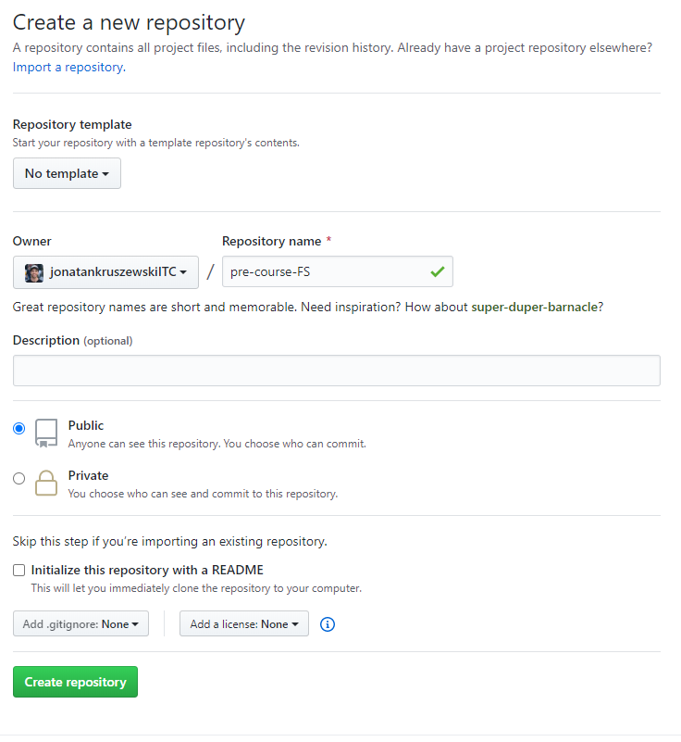
Deploying to Github Pages
#2 A: Case there is no remote repository:
Give it a name. No spaces allowed.

Slide 13
Deploying to Github Pages
#2 A: Case there is no remote repository:
Create it public, so everybody can see your code.
Don’t create a readme neither gitignore or license for now.
If you create a Readme or with a .gitignore file, there is going to be a pre existent commit. That means, that when connecting to the remote, there is going to be needed to pull.
You won’t be able to push (publish) if you didn’t pull first.
Pulling might involve solving conflicts
Let’s avoid that for now.

Slide 14
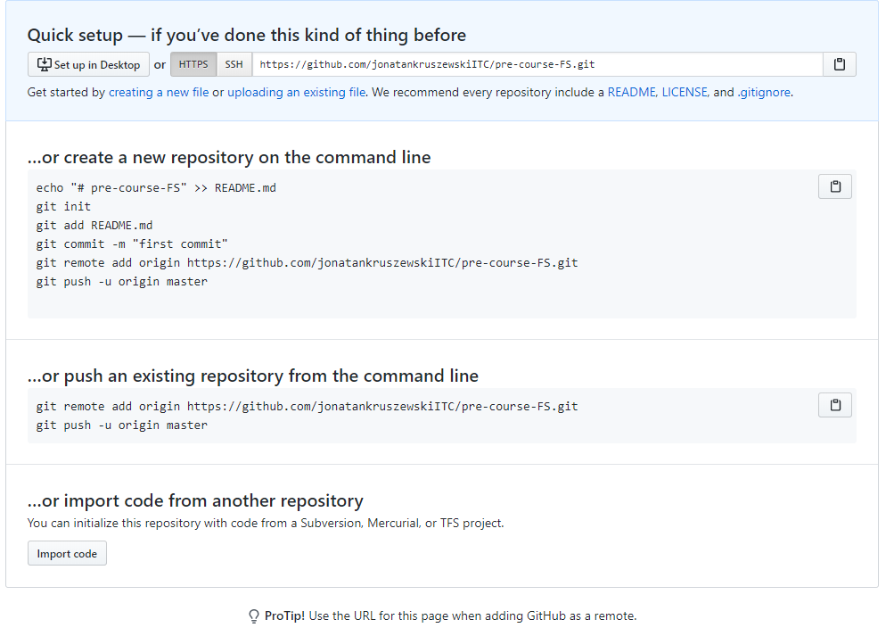
Deploying to Github Pages
#2 A: Case there is no remote repository:
Copy the remote repository address. Pay attention to which option you need to use.
After creating the repository, we need to grab the link. The link could be expressed as two different addresses:
HTTPS
SSH Keys.
If you have created SSH Keys for your account you can go for that option, if not go for HTTPS.

Slide 15

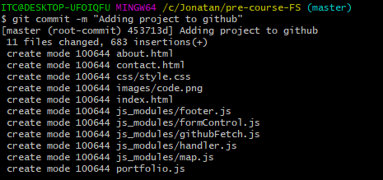
Deploying to Github Pages
#2 A: Case there is no remote repository: Back to the terminal to publish our work.
Type in git init and hit enter.
Initializes a git repository
Type in git remote add origin + your link
Links the local repository to a remote one
Type in git add . + enter
Stages all the changes
Type in git commit -m “some message” + enter
Commiting the changes

Slide 16
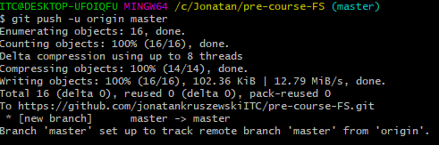
Deploying to Github Pages
#2 A: Case there is no remote repository: Back to the terminal to publish our work.
After commiting:
Once created the commit, we will see the log of the changes
Type in git push -u origin master + enter
Publishes the changes to the master branch in the remote named origin. The -u means set upstream. That means, that from now on, every time that on that branch the command git pull / git push is run, it will automatically do git pull origin master or git push origin master.

Slide 17
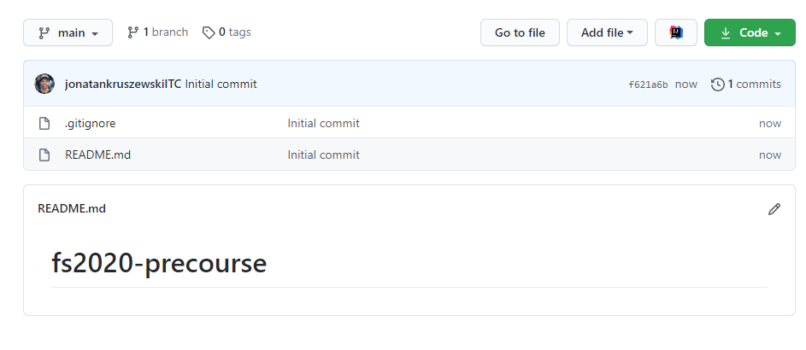
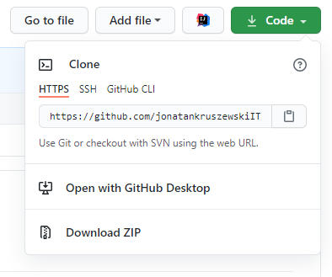
Deploying to Github Pages
#2 B: Case there is already a remote repository
Let’s say that there is already a remote repository for our project and it contains commits that we don’t. This could be the case of an already initialized project, or a project that contains a .gitignore file or a readme (and thus, a commit)

Slide 18
Deploying to Github Pages
#2 B: Case there is already a remote repository
Let’s grab the link.
In the project folder, open a terminal window.

Slide 19
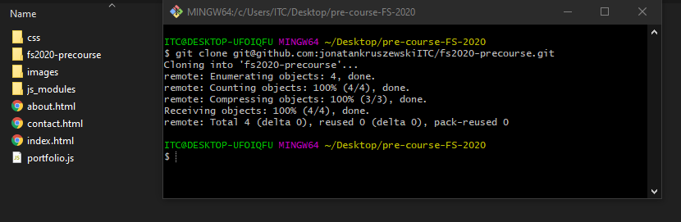
Deploying to Github Pages
#2 B: Case there is already a remote repository
Don’t clone it here: cloning it will create a new folder, and inside of that folder the project. If we hadn’t created any work yet, this option for sure would be the shortest.

Slide 20
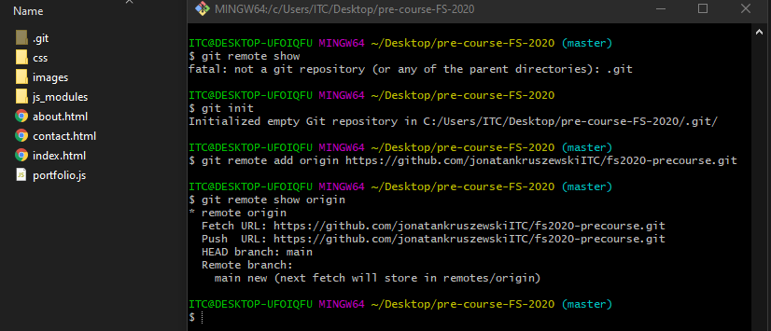
Deploying to Github Pages
#2 B: Case there is already a remote repository
git remote show: shows if there is a remote.
git init: Since there wasn’t, we create one. Pay attention that afterwards running this command a .git hidden folder is created.
git remote add origin <url>: links this repository to the one of the address.
git remote show origin: Shows details about origin. What interests us, is the name of the remote branch (HEAD branch). In this case, is main.

Slide 21
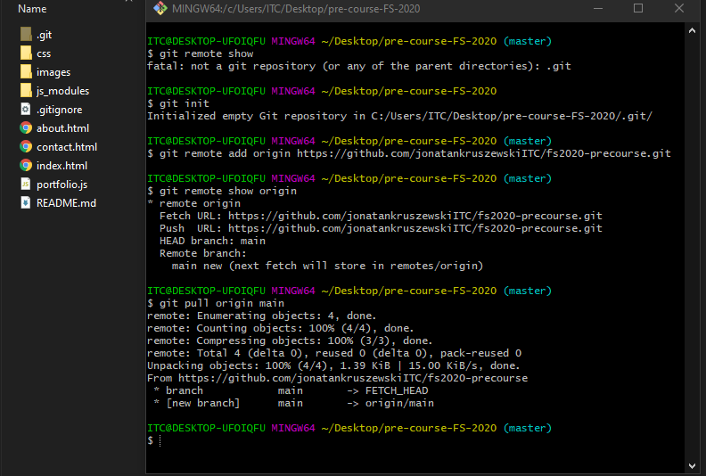
Deploying to Github Pages
#2 B: Case there is already a remote repository
git pull origin main: bring the commits from the remote named origin at the branch named main.
Pay attention that we have the remotes files too.
If you have commits, you might need to solve conflicts or use the additional flag --allow-unrelated-histories.

Slide 22
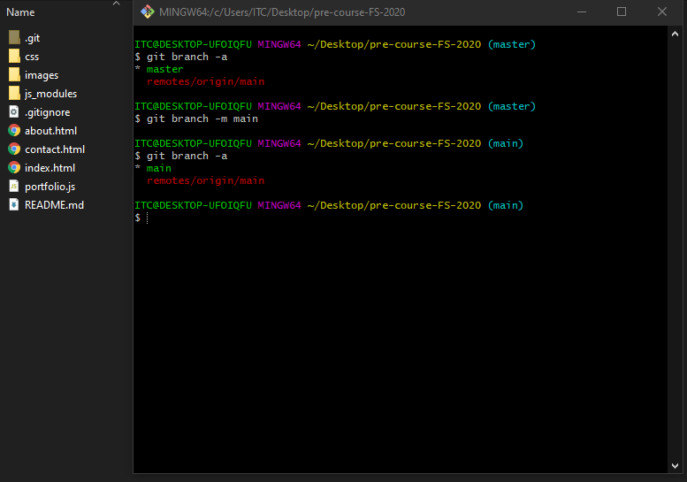
Deploying to Github Pages
#2 B: Case there is already a remote repository
git branch -a: check our local branches. We need to make sure that our local branch gets the same name as the remote’s. In the remote is named main, but locally master. Let’s fix that. If their names match, no need to rename any of them.
git branch -m main: rename the local branch to main.
Now we are set, let’s commit the local files.

Slide 23
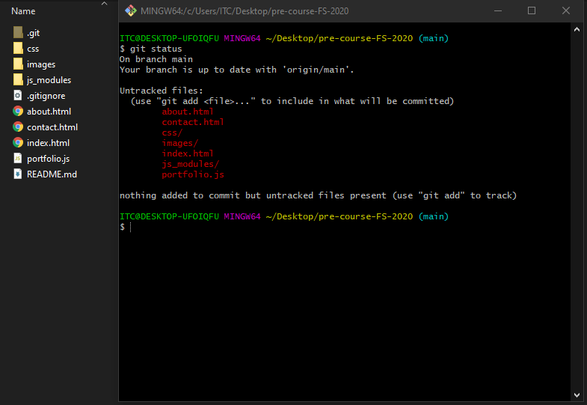
Deploying to Github Pages
#2 B: Case there is already a remote repository
git status: Shows information about the changes since the last commit. On our case, the latest commit is the one pulled from the remote. The changes are that there are new files (about.html, etc).
Let’s commit them too.

Slide 24
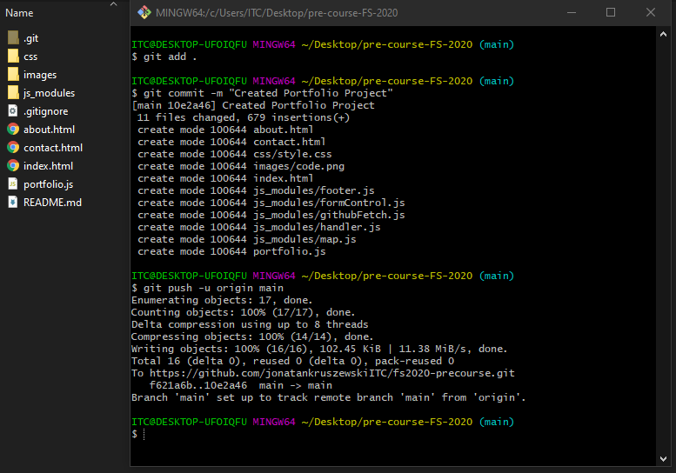
Deploying to Github Pages
#2 B: Case there is already a remote repository
git add: specifies which files to add to the commit. A -a or a dot ‘.’ will indicate add all files.
git commit -m: commits locally.
git push -u origin main: pushes to the main
From now on, we can continue with the deployment on Github pages, or creating new commits.

Slide 25
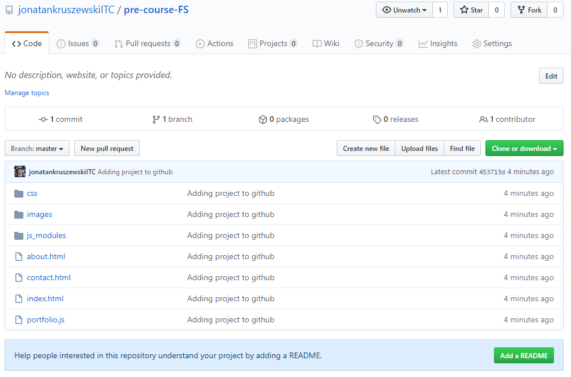
Deploying to Github Pages
#3: Publish your work
When you pushed, you published your work. After all this steps, you should see the same files in the GitHub repository.
Now we are ready to deploy to Github Pages

Slide 26
Deploying to Github Pages
#3: Publish your work.
Keeping your work updated by repeating the git add + git commit + git push.
Every time that you keep on working and you finish some part of your project, repeat the steps:
Git add .
Git commit -m “message”
Git pull origin <main_or_master> + solve conflicts (you shouldn’t have because you are the only one creating commits in the remote, but it is a good practice)
Git push (use the -u origin master only the first time)

Slide 27
Deploying to Github Pages
#4: deploying to Github Pages.
Go to the repository settings and activate the option

Slide 28
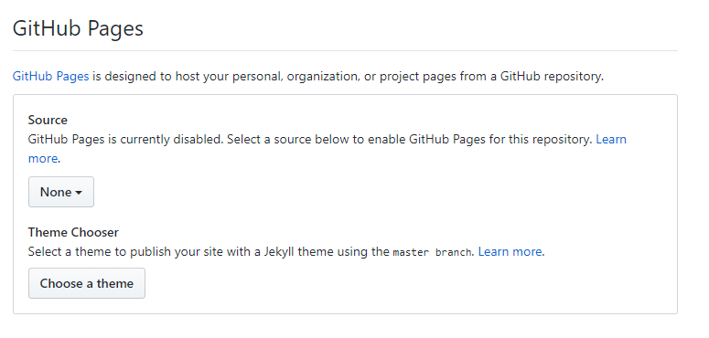
Deploying to Github Pages
#4: deploying to Github Pages.
Under GitHub Pages in the settings, select the branch that you would like to deploy. Probably the default branch (main or master)

Slide 29
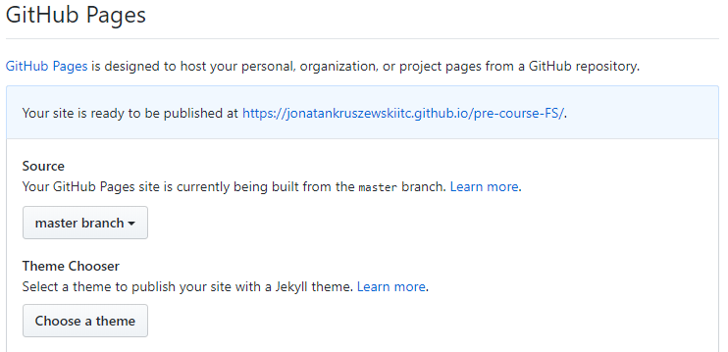
Deploying to Github Pages
#4: deploying to Github Pages.
Once finished (may take several minutes), you will have it available under that link.

Slide 30
Connecting to two repositories
If for any reason, you don’t have access to the settings of the repository, you can create a new one and link your local repository to two (or more) remotes.
🤯
That means, that we can keep a remote always updated with 2 remotes or more. The advantages:
One could be use for development, experimenting, creating new features
While the second remote may only contain the production branch.
That way, production remains separated from development.

Slide 31
Deploying to another repo
To link a local repository to more than one remote:
Create a new repository.
Copy the repository address.
In your local project, add it as a new remote. We will call it deployment:
git remote add deployment <url_of_your_repository>
Then, in the main branch (or the one that you want to deploy to that repository) do:
git push deployment main
This will push the code to the remote deployment. When pushing, pay attention to which remote you are to track to which remote you are pushing to. Remember that you can always change the upstream branch using:
git branch -u <remote_name>/<remote_branch>
From this point, you can deploy to Github pages on the new repository.

Slide 32
Summary
We installed git / checked we had it installed
We created a repository on GitHub
We linked our project folder in our computer to the online repository
We commited files and pushed them to the repository
We deployed the project using GitHub pages

